Slide 1
Fivetran
deployment options

Slide 2
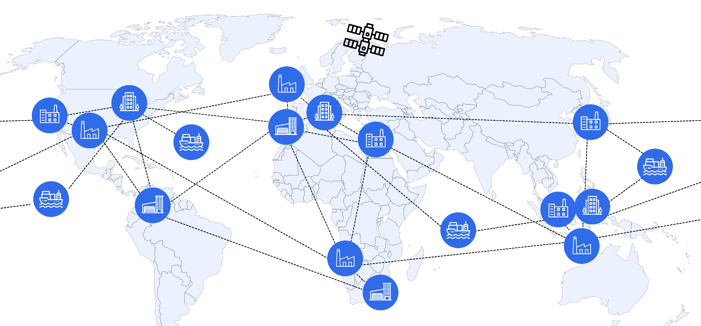

Fivetran: A single platform to securely move your data wherever or however it exists
Notes:
With Fivetran, you can “Move your data wherever and however it exists”
From cloud, on-prem, saas applications, legacy db, and even edge systems – like factories, ships, or the international space station
You can simultaneously deploy your workloads in our managed service, hybrid deployments, and on-prem, in any geography you need
Fivetran is the single platform you need to securely move all of your data wherever or however it exists for all industries - HLS, FinServ, Government, Manufacturing, Consumer Goods, and beyond

Slide 3



Enterprises must consider data safety, security, and compliance
44%
Of C-suite leaders cite data governance and security as a challenge
Source: MIT Technology Review Insights survey, 2024
Notes:
Double-clicking a bit into the data safety, security, and compliance topic - As government regulations like GDPR, HIPAA, and CCPA continue to tighten, and new ones are introduced, enterprises are under increasing pressure to ensure their data practices meet strict security and compliance standards. Recent breaches in technology, healthcare and financial services industries have highlighted the risks of exposing sensitive information and compromising critical systems. DIY or self-managed pipelines can introduce vulnerabilities, especially as teams make updates to meet rapidly changing data needs, that lead to higher risk of such breaches. So, keeping your data secure must be a top priority for all organizations as they undergo pipeline modernization and data centralization efforts.

Slide 4
Enterprises need a modern data movement solution that also fits their enterprise security protocols
Unlock the potential of your data
Centralize security-restricted data sources:
Patient data
Financial data
Customer data
With the rest of your organization’s data
In a managed approach, with no security tradeoffs
Your secure environment/VPC
Your security protocols
No maintenance
Supported by a team of experts
Easy to use interface
Securely move data to the cloud
+
Notes:
With Hybrid deployment - we have created a single enterprise-grade platform for all of your data movement needs.
Utilize Fivetran’s fully-automated, reliable connectors to move all of your application, database, ERP data, and more.
Now, you can also choose to deploy sensitive data pipelines in your secure environment, ensuring data never leaves your network and abides by your control.
This meets the needs of security restricted industries - HLS, Government, FinServ - and gives you the ability to move sensitive data that cannot leave your controlled environment - customer data, patient data, financial data - without needing to build or maintain your own pipelines or technology.

Slide 5







Several ways to deploy Fivetran
Example architectures
SaaS
Data movement is fully-managed from Fivetran’s cloud-based platform.
Customer network
Fivetran network
Destination network
Source DB
Fivetran Platform
Destination
Fivetran network
Hybrid
The control plane is hosted in the cloud but data is processed in your secure environment.
Fivetran Platform
METADATA
Destination network
Customer network
On-prem or cloud
Source DB
Pipeline Processing
Destination
Self-Hosted
Self-host HVR in your local environment for high-volume replication.
Customer network
Destination network
Source DB
HVR
Destination
Notes:
There are several ways you can deploy Fivetran:
Fivetran can be deployed as SaaS, for the fully-managed experience that thousands of organizations have come to rely on. With SaaS, you utilize Fivetran’s best-in-class cloud-based platform for reliable, secure, automated data movement.
For companies with higher volume database replication, on-prem to on-prem, or fully air-gapped needs, Fivetran can also be self-hosted with our HVR technology.
And, we are now excited to announce that for companies who want a managed experience, but also need to keep data movement in their own environment or VPC, Fivetran now supports a hybrid deployment method. With Hybrid, organizations can deploy pipelines in their secure environment right from Fivetran’s fully-managed platform.

Slide 6
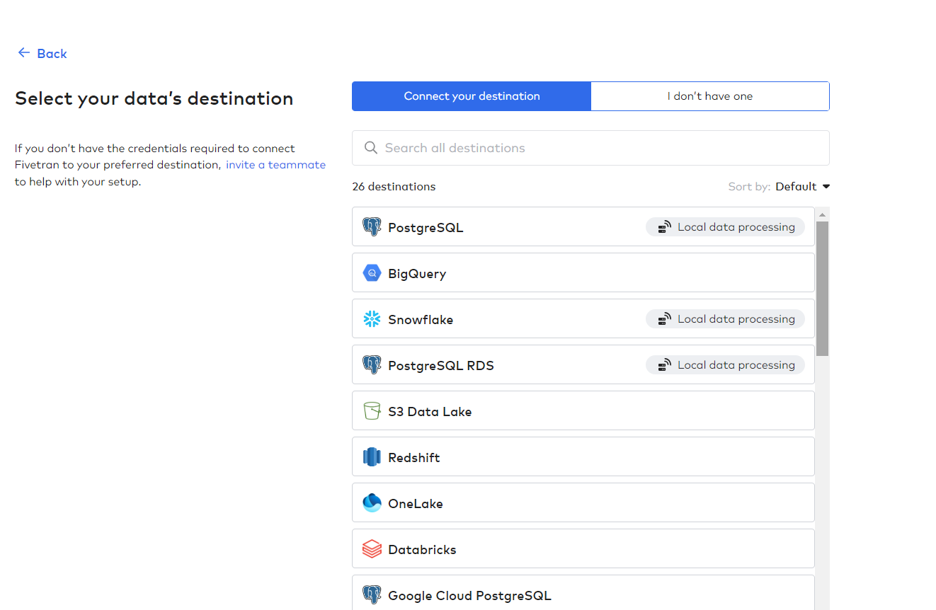
Hybrid deployment
Take advantage of Fivetran’s cloud-hosted platform, while processing your sensitive data in your secure environment
Secure
Customer data is processed locally and never leaves your environment or VPC
Simple
Single control plane lets you manage, setup, and control your data movement with ease and configurability - no manual maintenance required
Reliable
24/7/365 monitoring & incident response by 500+ engineers
Customer network
Source DB
Fivetran network
Pipeline Processing
Fivetran Platform
METADATA
Destination network
Destination
99.9% uptime
1 min latency
Available as a free feature in Enterprise and Business Critical Fivetran
Notes:
With Hybrid deployment - a feature in our Enterprise and Business Critical plans available at no additional cost - you get a single, easy to use platform for all your data movement needs:
Run security restricted application or database pipelines in your secure environment
Take advantage of Fivetran’s library of over 500 automated connectors, running in your network or in Fivetran’s cloud
Maintained, monitored, and supported by Fivetran’s always on support and engineering team
Ensuring you get the data you need, all in your control, without sensitive data leaving your network
This benefits the organization by:
Reducing technical burden, as you don’t need to build or maintain on-premise pipelines manually
Freeing up your technical resources, as you get the full support of Fivetran’s engineering and support teams
Unlocking new insights, as you can move and centralize sensitive data that otherwise might have been left out of your centralized repository
All with ease of use of Fivetran’s platform and the agnostic approach to support your architecture

Slide 7
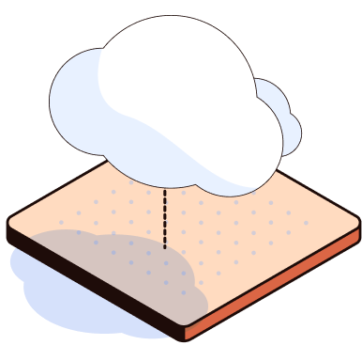


Hybrid deployment
NEW
Cloud-based control plane
A single platform for all of your data movement needs, offering 99.9% uptime and a selection of 500+ managed data connectors.
A managed service that meets the strictest enterprise security protocols.
Secure pipelines in your environment
Self-host pipelines to move database, Salesforce and other sensitive data under your security protocols, without it leaving your VPC.
Complete data protection
Fivetran provides secure single-sign-on, enterprise compliance certifications and data encryption in transit and at rest.
Notes:
Our new hybrid deployment offering is designed for security-conscious organizations that don’t want to sacrifice performance on legacy methods. Leverage Fivetran’s cloud-based, automated data movement platform, while processing data in your secure environment. Enjoy the security of Self-hosted Deployment, along with the simplicity of Fivetran’s dashboard and the reliability of our 24/7 monitoring and 500+ engineers. Fivetran processes sensitive data via a control plane that is evoked by a local processing agent deployed within your own secure environment. This allows you to ensure that your data processing meets the security requirements and protocols of your own VPC and gives you complete control over your data as the automated replication occurs within your own environment.

Slide 8


“The simplicity of management is the best value of Hybrid Deployment. I know the status of our pipelines and can launch and manage cloud-based and on-premises pipelines directly from one platform. Given our history with on-prem applications, I can say that pipelines going down and requiring restart was quite cumbersome, but Hybrid deployment has been considerably different. I can realize the ease of monitoring and maintaining pipelines with immediacy. The ability to quickly stand up Hybrid deployment for on-prem data movement, while managing it from a straightforward and familiar cloud-based control plane, is a great value add.”
Powell Industries is a global manufacturer of Integrated / Packaged Solutions and Electrical Equipment to monitor and control the distribution of electrical power in commercial and industrial markets.
They leverage the Fivetran automated data movement platform for multiple data workloads in Snowflake including:
Oracle and SQL Server database replication for cloud data warehousing and data engineering
Fivetran SaaS, Fivetran Hybrid and Fivetran HVR private deployment
Data democratization and readiness for AI, Fivetran Data Podcast Episode 5
Ajay Bidani
Data & Insights Manager, Powell Industries

Slide 9

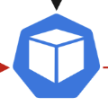
Hybrid deployment architecture
Fivetran Network
Control Plane
Private Container Registry
Fivetran Dashboard / API
Orchestration Endpoint (gRPC)
4.Metadata
1.Register & Get Jobs
2.Pull required image
Customer Network
Hybrid Deployment Agent
Source
Destination
3.Data pipeline processing
Data Plane
Notes:
With this model you have a single unified control plane where you can take advantage of the ease of use of the Fivetran managed service, but still meet the security requirements that a lot of our customers have that pipeline data must stay within your own environment.
You will go to Fivetran.com to monitor and configure all your connectors, regardless of whether they are deployed in the cloud, or locally in your environment.
You’ll install an agent locally that calls out to Fivetran to get information about what work needs to be done. The data itself is processed locally, never leaves your cloud or on-prem environment. It passes back metadata so we can display the metrics and logs in the dashboard, and also so our support team can help troubleshoot when things go wrong.
We’re very excited about this new capability. It will help many more customers get faster time to value setting up new database sources, reduce the amount of infrastructure that you need to manage, as well as reduce overhead of having to monitor across two different tools.

Slide 10


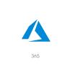






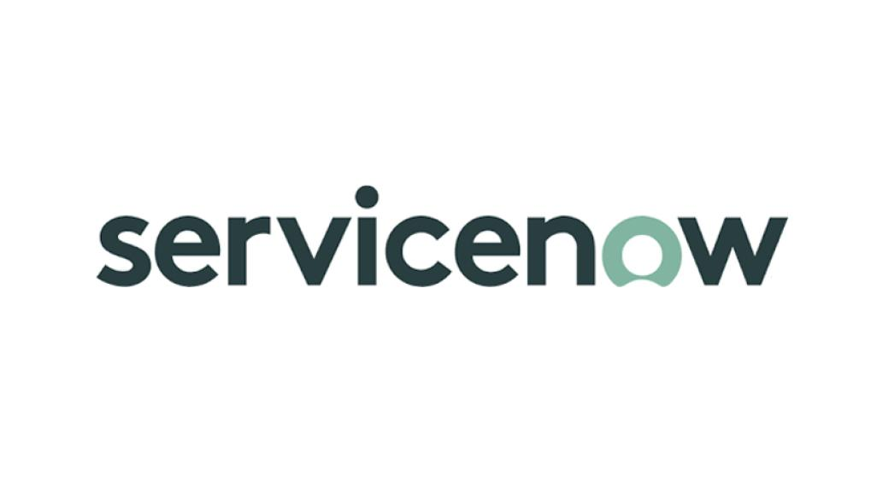



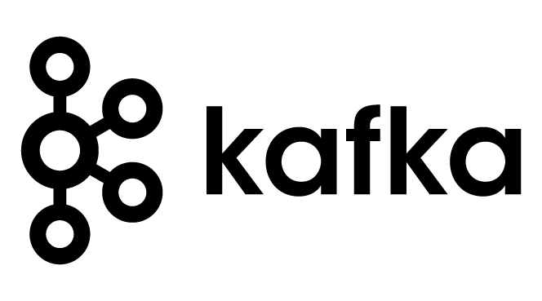
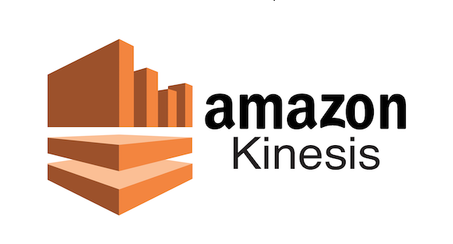




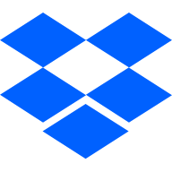





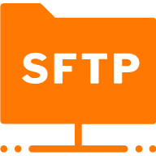
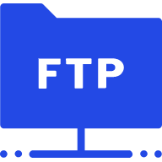

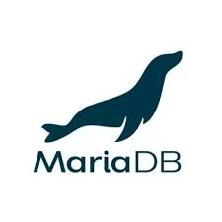




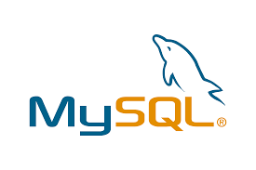

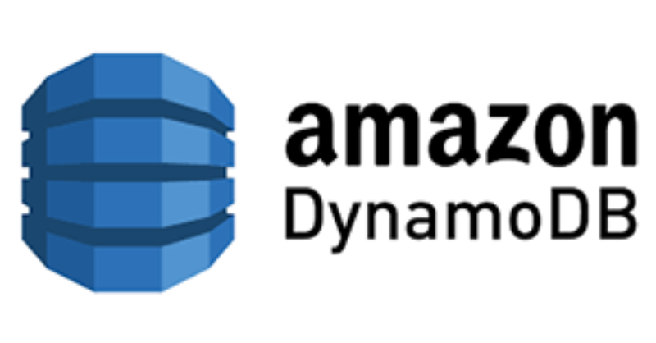
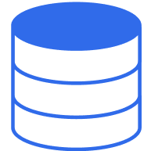

Use Fivetran to move all of your data
Fivetran network (in cloud)
Applications
Single platform management
Events
Files
Data lake
Databases
(Cloud/on-premise)
Outbound Connection, only logistics Metadata sent back
Data warehouse
Hybrid
Your network (on-premise)
Hybrid Deployment agent
Destination network (Cloud/on-premise)
Applications
On-prem pipeline
Databases
Sample Fivetran Reference Architecture
Notes:
Now, use Fivetran’s platform for all of your data movement needs.
Run secure pipelines in Fivetran’s secure cloud network.
For data that can’t leave your environment, choose to run those in your network, loading into your destination.
You now have one platform - that is cloud-, source-, and destination-agnostic - that can move all of your data, regardless of security concerns, how the data is stored, or where it needs to land.

Slide 11
Next Steps
(Partner to complete)

Slide 12
Thank You
Notes:
Will

